Slide 1
A Start
To
Finish
Course
DANILO II VEROY
Notes:
Goals, plans and expectations
Please follow along
Source code will be available if needed

Slide 2
Course Purpose
There are three main purposes for this course:
To provide a clear demonstration on how to build a industry practice application.
To demonstrate how various topics fit together.
To create a learning platform for future demonstrations.
Notes:
To practice us from the industry framework
Various topics that applies together
And for our leaning curved

Slide 3
TEAM’S goals
Modern Development
Application Growth
Upgrade Technologies
Demonstrate modern development techniques.
Model how an application grows over time.
Create a platform that needs to be upgraded to newer technologies.
Incorporate new tech
Hands-on Learning tool
Create a planform to demonstrate how to incorporate new technologies or tools into existing software.
Create a hands-on learning tool for developers to use to simulate a industry practice work environment.
Notes:
I want you to see how a dev approach and develop in industry practice
We want to see our program is growing
We learn to upgrade to new technologies and update the existing software
We will also want to upgrade our skills and knowledge by adopting new techniques or tools
This is a simulation for industry practice

Slide 4
Simulation Setup
In this simulation, we will build a solutions that we can then sell to clients. Right now, we have been assigned to build a POS System. Over time, we will get new requirements, or new work entirely, just like in our projects.
Preparation
Development
User Training Environments
Deployment
Notes:
We are here to learn and create a start from scratch project like POS.
Like a retail management system
We will learn from the start to deployment and also upgrade and adopt new tech

Slide 5
Initial Project
We need to build a desktop application that runs a cash register, handles inventory, and manages the entire store. In order to allow it to grow, though, we will be creating a WebAPI layer.
Initial Plan
We will build a MVP (Minimum Viable Product) that we can expand to cover all of the features we need over time. The first step is getting all of the major pieces set up, including:
Git or Azure DevOps
SQL Database (SSDT)
WebAPI with Authentication
WinForm application that can log into the API
Notes:
We are targeting to work with multiple platform. That’s why we will start with WebAPI

Slide 6
Upcoming Technologies
Unit Testing
Dependency Injection
WinForm
ASP.NET MVC
.NET Core
SSDT
Git
Azure DevOps
Design Patterns
Async
Reporting
WebAPI
Logging
Data Validation
HTML
CSS
JavaScript
Authentication
Notes:
1. Unit testing is a must!
2. Dependency Injection
3. WinForm with MVVM
4. ASP.Net MVC
5. Upgrade to .Net Core – Razor/Blazor
6. SSDT – SQL etc.
7. Design patterns – Solid principle
8. Async –for performance
9. Reporting system
10. WebAPI – controlling our central layer
11. Logging – tracking whats going on with the apps
12. Validation
13. Web app
14. Authentication – API and application

Slide 7
Lets Start!

Slide 8
PHASE 1
START TO FINISH COURSE
Visual Studio 2019
Git latest version
Github account
MSSQL Server any version
WEB API
Database structure
Winform Login
Authentication to API using Winform

Slide 9

Setting up a github repository

Slide 10

Creating a WeBAPI with authentication

Slide 11

Configuring swagger in webapi

Slide 12

SQL Database Project

Slide 13


Winform with MVVM Project setup AND Dependency Injection

Slide 14

Planning the register

Slide 15

SQL Database Table Creation

Slide 16

Winform Login form creation

Slide 17
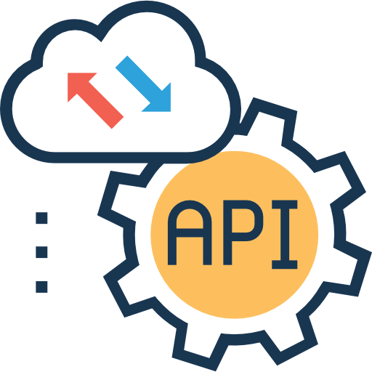
Wire up the Winform login form to the API

Slide 18

Login form error handling

Slide 19

Getting user data

Slide 20
Market overview
$3B
$2B
$1B
Opportunity to build
Fully inclusive market
Total addressable market
Freedom to invent
Selectively inclusive market
Serviceable available market
Few competitors
Specifically targeted market
Serviceable obtainable market

Slide 21
Market comparison
3
billion
Opportunity to build
Addressable market
2
billion
Freedom to invent
Serviceable market
1
billion
Few competitors
Addressable market

Slide 22
Our competition
Contoso
Competitors
Our curriculum is priced below that of other tools in the education market
Simple and easy to use, compared to the complex tools of the competitors
Affordability is the main draw for educators to adopt our products
Company A Product is more expensive
Companies B & C Product is expensive and inconvenient to use
Companies D & E Product is affordable, but inconvenient to use

Slide 23
Our competition
Convenient
Contoso Ltd.
Competitor A
affordable
Expensive
Competitor C
Competitor E
Competitor D
Competitor B
Inconvenient

Slide 24
SCALING FOR the future
Feb 20XX
Roll out product to local schools to establish new STEM curriculum
May 20XX
Release to regional school districts and monitor trends in each school
Oct 20XX
Gather feedback from teachers and continue to expand availability of the product

Slide 25
Traction
Key metrics
Revenue by year
 | Clients | Orders | Gross revenue | Net revenue
20XX | 10 | 1100 | $10,000 | $7,000
20XX | 20 | 200 | $20,000 | $16,000
20XX | 30 | 300 | $30,000 | $25,000
20XX | 40 | 400 | $40,000 | $30,000

Slide 26
Two-year action plan
Draft blueprints
Gather feedback
Deliver to students
20XX
JAN
FEB
Mar
Apr
May
Jun
Jul
AUG
SEP
Oct
Nov
Dec
20XX
Jan
Feb
Mar
Apr
May
Jun
Jul
Aug
SEP
Oct
Nov
Dec
Run focus groups
Test with schools
Regional launch
July, 20XX

Slide 27
Financials
 | YEAR 1 | YEAR 2 | YEAR 3
INCOME
Users | 50,000 | 400,000 | 1,600,000
Sales | 500,000 | 4,000,000 | 16,000,000
Average price per sale | 75 | 80 | 90
Revenue @ 15% | 5,625,000 | 48,000,000 | 216,000,000
Gross profit | 5,625,000 | 48,000,000 | 216,000,000
EXPENSES
Sales & marketing | 5,062,500 | 38,400,000 | 151,200,000 | 70%
Customer service | 1,687,500 | 9,600,000 | 21,600,000 | 10%
Product development | 562,500 | 2,400,000 | 10,800,000 | 5%
Research | 281,250 | 2,400,000 | 4,320,000 | 2%
Total expenses | 7,593,750 | 52,800,000 | 187,920,000

Slide 28



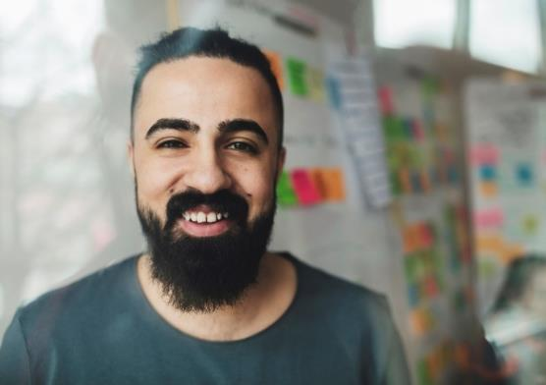
Meet the team
Takuma Hayashi​
Mirjam Nilsson​
Flora Berggren​
Rajesh Santoshi​
President
Chief Executive Officer
Chief Operations Officer
VP Marketing

Slide 29








Meet the FULL team
Takuma Hayashi
Flora Berggren​
Graham Barnes
Elizabeth Moore
President
Chief Operations Officer
VP Product
Product Designer
Mirjam Nilsson​
Rajesh Santoshi​
Rowan Murphy
Robin Kline
Chief Executive Officer
VP Marketing
SEO Strategist
Content Developer

Slide 30
funding
14,000
$12,000
$82,000
$32,000
Angel investments
Grants and donations
Shares
cash
Amount obtained through other investors
Revenue obtained from STEM grants and public donations
Number of shares converted into USD
Liquid cash we have on hand

Slide 31

Summary
At Contoso, we believe in giving 110%. By expanding STEM education tools, we help schools build a curriculum that will aid student success in college. We thrive because of our market knowledge and a great team behind our curriculum. As our CEO says, "Efficiencies will come from proactively transforming how we do business."

Slide 32
Thank you
Danilo II Veroy
danilo.veroy@direcbsi.com
https://direcbusiness.com/
0917-629-3444

